Slide 1
Our Calling
Using Media for Ministry

Slide 2
The Calling
Our Mission
The Power of Media
Indirect Communication

Slide 3
“And He said to them, Go into all the world and preach the gospel to every creature.” Mark 16:15

Slide 4
“Therefore go and make disciples of all nations, baptizing them in the name of the Father and of the Son and of the Holy Spirit, and teaching them to obey everything I have commanded you. And surely I am with you always, to the very end of the age.” Matthew 28:19-20

Slide 5
“This is to my Father’s glory, that you bear much fruit, showing yourselves to be my disciples.” John 15:8

Slide 6
Why use Media to fulfill the commission?
Media is powerful
It is where the people are

Slide 7
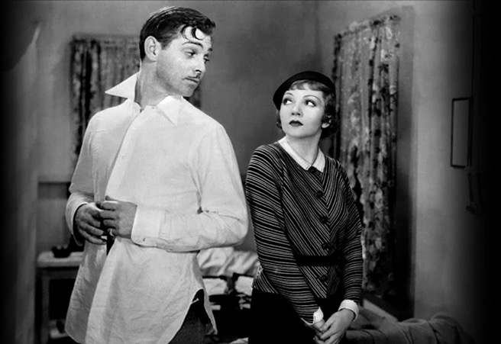
Media Effects
1934 Frank Capra film, “It Happened One Night” ​

Slide 8
Media Effects
1934 Frank Capra film, “It Happened One Night”​
Undershirt sales dropped by 75% Nation-wide​
Gottschalk, Mary. "AMC's Look at Hollywood Fashion Follows Fads from Screen to Closet. “Pittsburgh Post-Gazette. 17 August 1995 (p. C1). ​

Slide 9
Media Effects
By March 1986 there were 43 documented Russian roulette deaths directly attributed to imitations of the Russian roulette scene in the 1978 film, The Deer Hunter​
Coleman, L. (2004). The copycat effect: How the media and popular culture trigger the mayhem in tomorrow’s headlines. New York: Paraview.

Slide 10
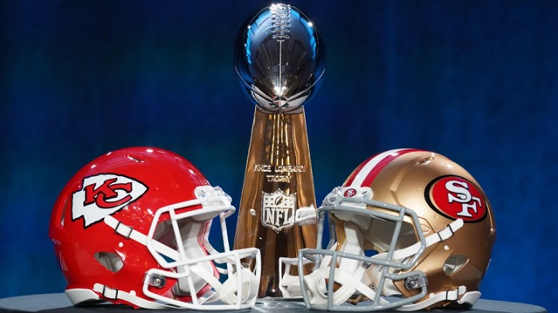
Media Effects
2020 Super Bowl adds cost approx. $5 million for a ​30 sec. spot​

Slide 11
Five Types of Media Effects​
Cognitive-Type Effect: Media can effect what we know by planting ideas and information into our minds. The most prevalent media effect.​
Attitudinal-Type Effect: The media can create and shape our opinions, beliefs and values.​
Emotional-Type Effect: The media can make us feel things. They can trigger strong emotions such as fear, rage, and lust.​
Physiological-Type Effect: Media can influence our automatic bodily systems. These are usually beyond our conscious control.​
Behavioral-Type Effect: Media can trigger actions.​
Potter, W.J. (2011) Media Literacy 5th Ed. Los Angeles: Sage​

Slide 12
Bandura’s Social Learning Theory​
Individuals learn not only in classrooms but also by observing role models in everyday life, including characters in movies and television.​
​ Bandura, A. (1977). Social learning theory. Englewood Cliffs, NJ: Prentice-Hall​
Bandura, A. (1986). Social foundations of thought and action: A social cognitive theory. Englewood cliffs, NJ: Prentice-Hall​

Slide 13
Where people are
Children ages 8-12 in the United States spend 4-6 hours a day watching or using screens, and teens spend up to 9 hours.
American Academy of Child and Adolescent Psychiatry, Feb. 2020
American adults spend more than 11 hours per day watching, reading, listening to or simply interacting with media.
Nielson, 2018
People in the Philippines spend an average of 10 hours online every day, according to the Digital 2019 report.
Emily Dixson, CNN, Feb. 2019

Slide 14
Indirect Communication
What is it?
Why is it effective?

Slide 15
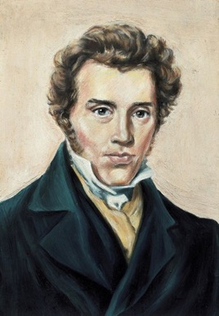
What is indirect communication?
“It is naturally the error of the modern period that all communication is direct, that it has forgotten that there is such a thing as indirect communication.” Soren Kierkegaard
Narrative, story, nuance, hidden meanings.

Slide 16
Overhearing the Gospel

Slide 17
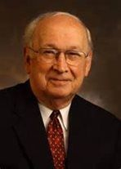
Overhearing the Gospel
“You and I are not sharing the gospel as pioneer missionaries chopping our way through the jungle to bring the fresh, new, first-time word to startled villagers. Perhaps most of us have in times of disappointment wished it were so, idealizing such occasions as opportunities to write the message on new tablets. Of course, there are no new targets. . .those who hear me have been sitting before the pulpit for two thousand years. Even for the casual listeners there is a fairly high degree of predictability in the sermon, and surrounding the whole occasion is the dead air of familiarity. ‘We have been here before, and here we go again.’” Fred B. Craddock, Overhearing the Gospel 2002, p. 16 & 17.

Slide 18
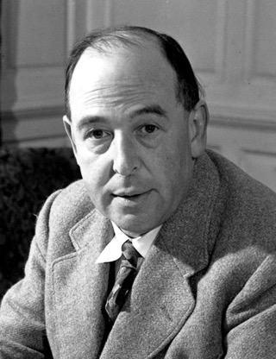
C.S. Lewis
“For me, reason is the natural organ of truth; but imagination is the organ of meaning. Imagination, producing new metaphors or revivifying old, is not the cause of truth, but its condition.”
C.S. Lewis, Mere Christianity

Slide 19
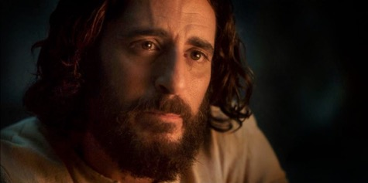
Jesus’ method
“Jesus sought an avenue to every heart. By using a variety of illustrations, He not only presented truth in its different phases, but appealed to the different hearers. Their interest was aroused by figures drawn from the surroundings of their daily life. None who listened to the Savior could feel that they were neglected or forgotten. The humblest, the most sinful, heard in His teaching a voice that spoke to them in sympathy and tenderness.”
Ellen White, Christ’s Object Lessons

Slide 20
Media and Indirect Communication
“The arts are a natural medium for imaginative indirect forms of communication.”
Benson P. Fraser, 2020 Hide and Seek: The Sacred Art of Indirect Communication

